Slide 1
Analyzing São Paulo data and open a new restaurant in the city
Rodrigo Mendrico
01/2021

Slide 2
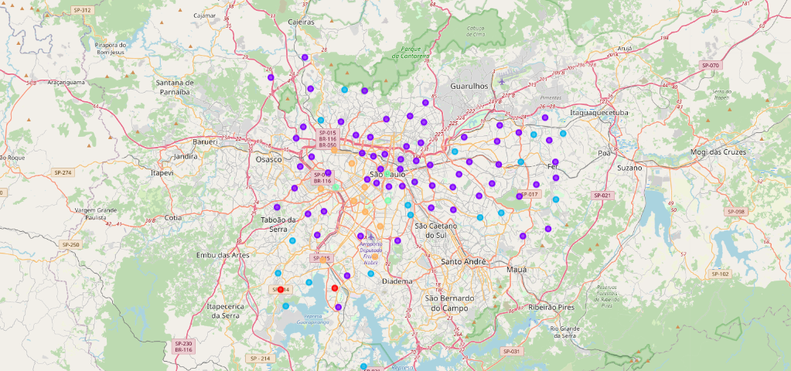
Analyzing income
We were able to identify the regions where the population has the larger income

Slide 3
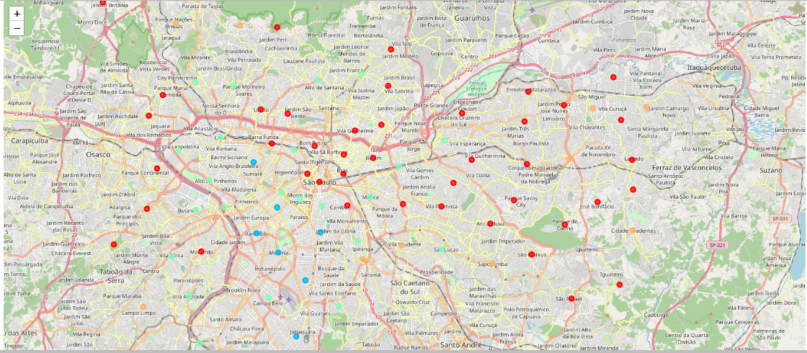
Education Data Clustering
We were able to identify the regions with higher education

Slide 4
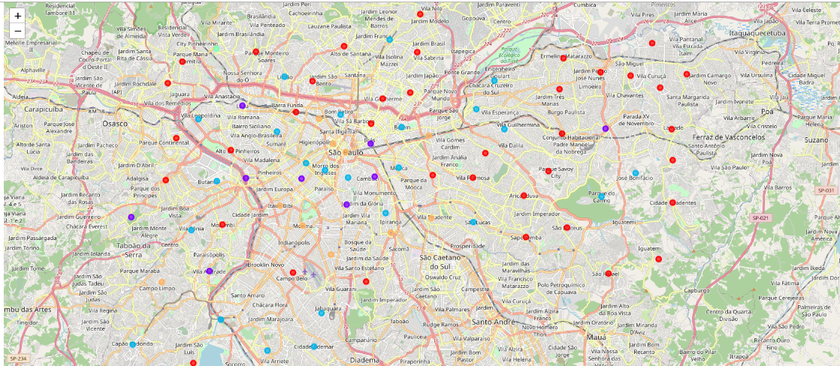
Houses Building Cluster
We were able to identify the regions with more investment. Besides the regions with more new houses will have more demand for customers.

Slide 5
Conclusion
We analyzed the following data:
Foursquare data for categories in each neighborhood
Income data
New houses building
Using this methodology, we can conclude therefore that we could open a new Italian Restaurant on Itaim Bibi, a new Vegan restaurant on Saude or a new Brazilian restaurant on Moema neighborhood.¶

